Slide 1
Introduction to Python Programming
DFP40203 PYHTON PROGRAMMING
Notes:
https://courses.cs.washington.edu/courses/cse142/10au/_python/week2/

Slide 2
What is Python?
Python is a popular programming language. It was created by Guido van Rossum, and released in 1991.
It is used for:
web development (server-side),
software development,
mathematics,
system scripting.

Slide 3
What can Python do?
Python can be used on a server to create web applications.
Python can be used alongside software to create workflows.
Python can connect to database systems. It can also read and modify files.
Python can be used to handle big data and perform complex mathematics.
Python can be used for rapid prototyping, or for production-ready software development.

Slide 4
Basic Principles of Python
Python works on different platforms (Windows, Mac, Linux, Raspberry Pi, etc).
Python has a simple syntax similar to the English language.
Python has syntax that allows developers to write programs with fewer lines than some other programming languages.
Python runs on an interpreter system, meaning that code can be executed as soon as it is written. This means that prototyping can be very quick.
Python can be treated in a procedural way, an object-oriented way or a functional way.

Slide 5
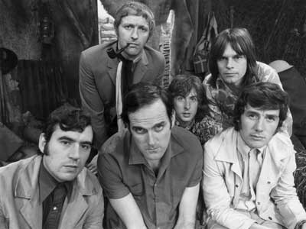
Python!
Created in 1991 by Guido van Rossum (now at Google)
Named for Monty Python
Useful as a scripting language
script: A small program meant for one-time use
Targeted towards small to medium sized projects
Used by:
Google, Yahoo!, Youtube
Many Linux distributions
Games and apps (e.g. Eve Online)

Slide 6






Python is used everywhere!

Slide 7
Interpreted Languages
Interpreted
Not compiled like Java
Code is written and then directly executed by an interpreter
Type commands into interpreter and see immediate results
Java:
Code
Compiler
Runtime
Environment
Computer
Python:
Code
Interpreter
Computer

Slide 8
Installing Python
Windows:
Download Python from http://www.python.org
Install Python.
Run Idle from the Start Menu.
Notes:
http://python.org/ftp/python/3.1/python-3.1.msi

Slide 9
Installing and Python Environment Setup
Step 1. Install Python
Python v3.1 Installer
Click the link above to download the Python installer. Once downloaded, run the program to install Python.
Step 2. Run The IDLE Editor
IDLE is an interpreter/editor combo called found under "Start -> Programs -> Python 3.6.5 -> IDLE (Python GUI)". To create a new Python script, go to "File -> New Window" (CTRL+N). Here you can type out your Python code, save it, and then run it by selecting "Run -> Run Module" (F5). A benefit of the IDLE environment is that you can test Python commands in the Python Shell window ("Run -> Python Shell"), which contains the Python interactive interpreter.
To use the Python interpreter alone, run "Start -> Programs -> Python 3.6.5 -> Python (command line)". Here you can type Python commands into the window interactively.

Slide 10
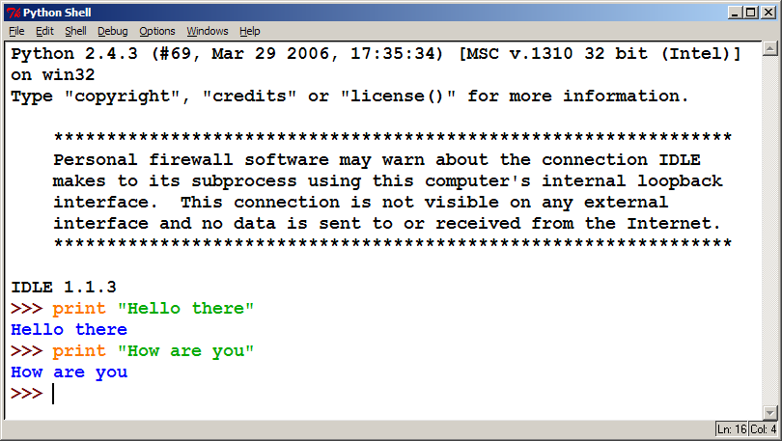
The Python Interpreter
Allows you to type commands one-at-a-time and see results
A great way to explore Python's syntax
Repeat previous command: Alt+P

Slide 11
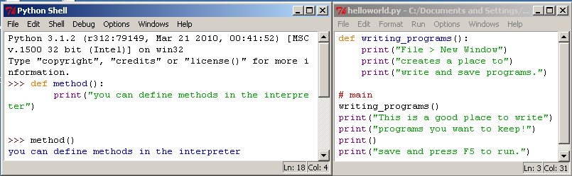
How to run Python Windows
Run IDLE to use the interpret
Open a new window in IDLE to write and save programs

Slide 12
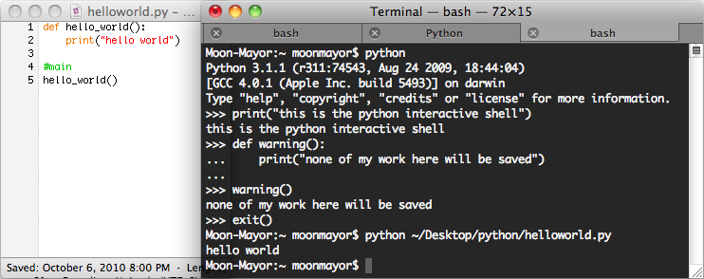
How to run Python Unix
Start the interactive shell with python
Run a program with python /path/to/program.py

Slide 13
Chapter 1 Review
Console output: System.out.println();
Methods: public static void name() { ... }
Hello2.java
1 2 3 4 5 6 7 8 9 | public class Hello2 { public static void main(String[] args) { hello(); } public static void hello() { System.out.println("Hello, world!"); } }

Slide 14
Our First Python Program
Python does not have a main method like Java
The program's main code is just written directly in the file
Python statements do not end with semicolons
hello.py
1 | print("Hello, world!")

Slide 15
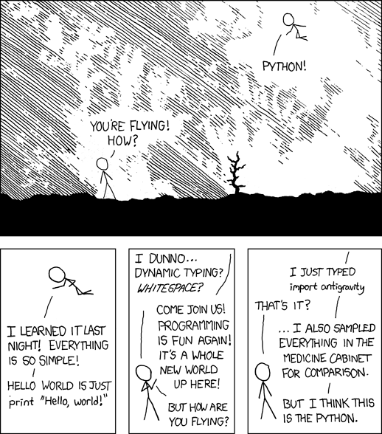
A Brief Review

Slide 16
Python 2.x vs Python 3.x
We will be using Python 3 for this course
Sometimes we may refer to Python 2
The differences are minimal
How to | Python 2.x | Python 3.x
print text | print “text” | print(“text”)
print a blank line | print | print()

Slide 17
python
print()
Words you will learn today

Slide 18
The print Statement
print(”text")
print() (a blank line)
Escape sequences such as \" are the same as in Java
Strings can also start/end with '
swallows.py
1 2 3 4 | print("Hello, world! ") print() print("Suppose two swallows \"carry\" it together.") print('African or "European" swallows?')

Slide 19
Comments
# comment text (one line)
# must start each line of comments with the pound sign
swallows2.py
1 2 3 4 5 6 | # Suzy Student, CSE 142, Fall 2097 # This program prints important messages. print("Hello, world!") Print() # blank line print("Suppose two swallows \"carry\" it together.") Print('African or "European" swallows?')

Slide 20
Functions
Function: Equivalent to a static method in Java.
Syntax:
def name():
statement
statement
...
statement
Must be declared above the 'main' code
Statements inside the function must be indented
hello2.py
1 2 3 4 5 6 7 | # Prints a helpful message. def hello(): print("Hello, world!") # main (calls hello twice) hello() hello()

Slide 21
Whitespace Significance
Python uses indentation to indicate blocks, instead of {}
Makes the code simpler and more readable
In Java, indenting is optional. In Python, you must indent.
You may use either tabs or spaces, but you must be consistent
hello3.py
1 2 3 4 5 6 7 8 | # Prints a welcoming message. def hello(): print("Hello, world!") print("How are you?") # main (calls hello twice) hello() hello()

